Slide 1

EXPLORATORY ANALYSIS OF APPLE STOCK PRICES (1980-2022)
Group Members
Adan Ordonez
Priyanka Patil
Vijval Vemula
Tyler Brenner
Prof : Milad Toutounchian
Subject: DSCI521

Slide 2
Outline
Introduction
Data Exploration
Data Visualization
Summary Statistics
Event Analysis
Daily Returns
Outlier Detection
Seasonal Patterns
Correlation Analysis
Moving Averages
Volume Analysis
Volatility Analysis
Technical Indicator
Conclusion

Slide 3
Introduction
Analyze historical Apple stock prices from 1980 to 2022
Gain insights into long term trends, volatility, patterns
Identify events that impacted stock price
Understand relationship between Apple stock and broader market
Visualize Apple stock price over time using charts
Detect seasonal patterns or recurring trends
Derive key insights to inform trading, modeling, and predictions

Slide 4
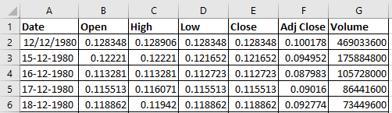
Data Exploration
Prices from 1980 to 2022
Contains daily open, high, low, close prices
Also includes trading volume data
Data fields:
Date
Open Price
High Price
Low Price
Close Price
Volume

Slide 5
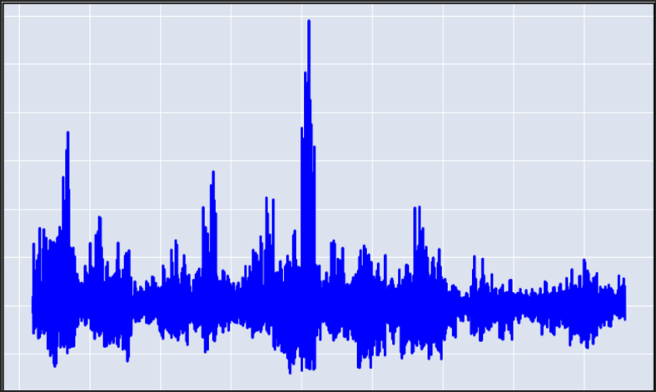
Data Visualization
Visualizing data provides a quick overview of stock price trends.
The chart helps in understanding volatility and potential patterns.
Deeper analysis will uncover the underlying factors driving these trends.

Slide 6
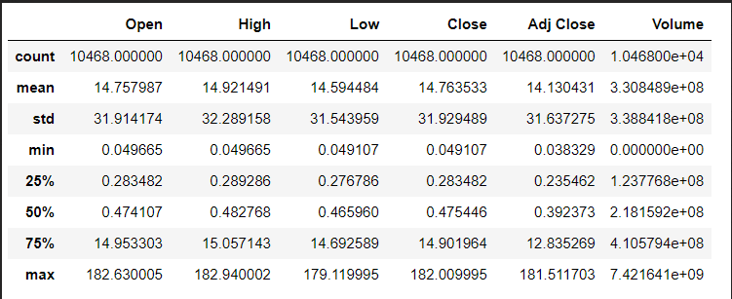
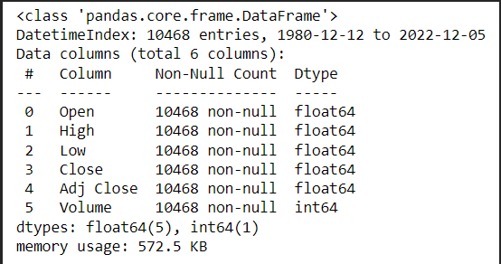
Summary Statistics

Slide 7
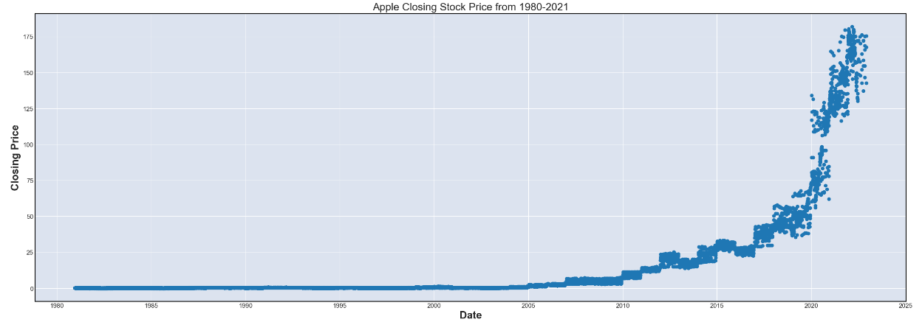
Event Analysis
Visualizes long term trends and volatility
Key events highlighted:
1984: First Macintosh computer launched
1997: Steve Jobs returns as CEO
2001: First iPod launched
2007: First iPhone launched
2010: iPad launched
2011: Steve Jobs passes away
2020: New Mac computers with Apple silicon

Slide 8
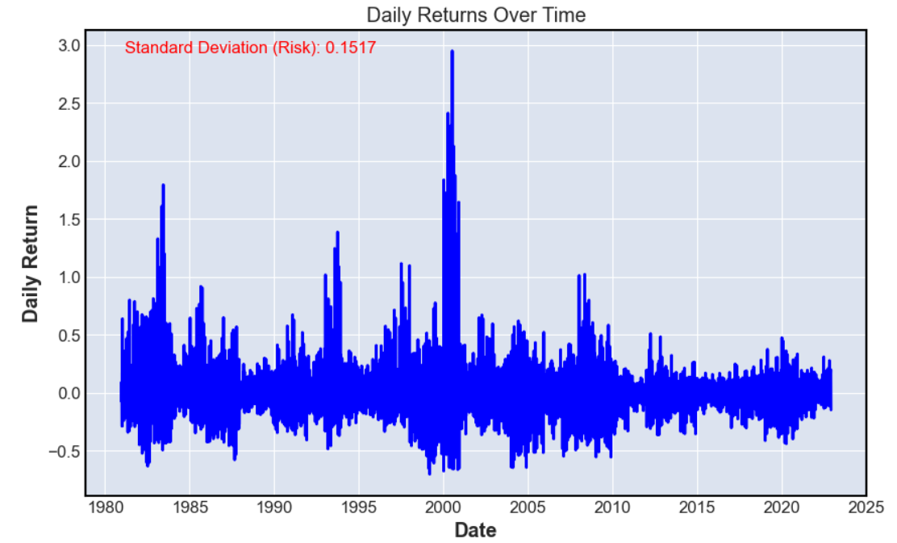
Daily Returns
Present a chart displaying daily returns (percentage change) of Apple stock prices over the years.
Analyzing the chart to identify periods of high and low volatility in daily returns.
Daily returns provide insights into short-term price movements.
Analyzing volatility and trends in daily returns is essential for investors' decision-making.
Daily returns analysis aids in risk management and strategy formulation.

Slide 9
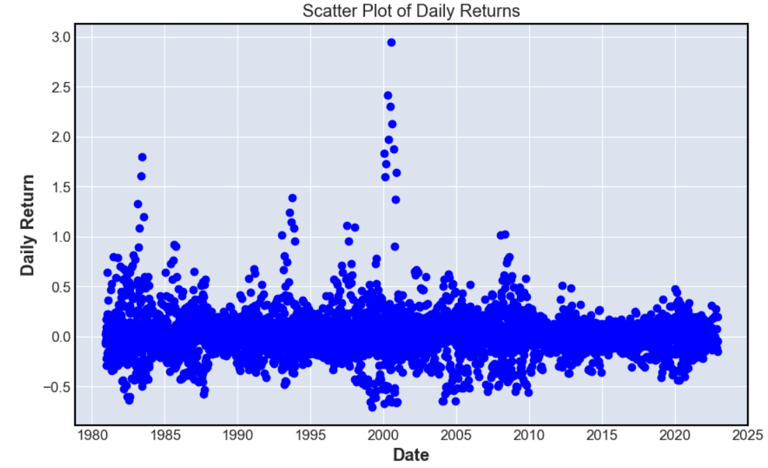
Outlier Detection
In this scatter plot, you can observe that Apple's stock is not very volatile and does not have many outliers.
This can mean that this stock is lower risk and is easier to predict the future of the stock.
This scatter plot indicates that there will not be many outliers in the future.

Slide 10
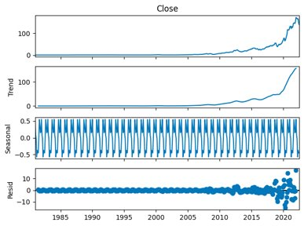
Seasonal Patterns
In the Seasonal plot table is that the stock is constantly changing with the seasons.
Every September Apple hosts an event where they launch their new products and the stock rises but as the new year hits, the stock starts to fall.
It appears around the time that Q1 earnings are announced, the stock starts to pick up and continue to rise for the rest of the year.​

Slide 11
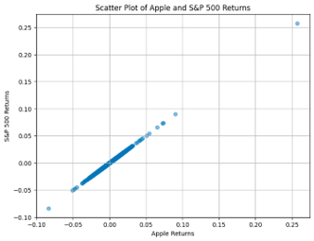
Correlation Analysis
Each point represents a pair of daily returns for Apple and S&P 500.
The position of the points relative to the diagonal line represents the correlation between the two.
Many points clustered along a straight line which indicates a strong correlation between the two.
Few points that are more spread out which indicate a weaker correlation between the two.
After calculating the correlation coefficient, which came out to 1, it appears that there is a strong correlation between the S&P 500's performance and Apple's performance.​

Slide 12
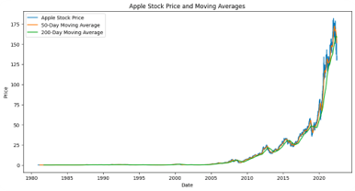
Moving Averages
The stock price was basically at the same rate as both the 50-Day and 200-Day Moving Averages from the start until around 2008.
Indicate that the market was in a period of balance and the amount, of buyers and sellers of the stock matched which led to the lack of significant price movement.
From the period of about 2008 until 2021, the stock was higher than both Moving Averages which indicates that the stock is in an uptrend phase.
From 2021, the Moving Averages were higher than the stock price and this can indicate that the stock may see a downtrend which would suggest the recent performance of the stock has been weaker and is lagging its historical averages.
Traders may interpret these moving averages as barriers that the stock needs to overcome to regain bullish momentum. ​

Slide 13
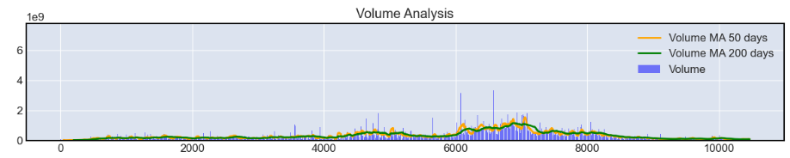
Volume Analysis
Volume analysis complements price analysis, providing insights into the strength and sustainability of price trends.
Significant volume spikes can be indicative of important market events.
Understanding volume patterns can help in making more informed trading decisions.
Volume reflects the number of shares or contracts traded during a specific time.
It's used to confirm the strength of price movements: higher volume during price increases indicates strong buying interest.
Volume moving averages (MA) smooth out volume data to identify trends in trading activity.

Slide 14
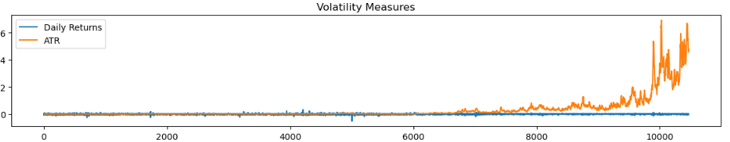
Volatility Analysis
Charts or graphs illustrating measures of volatility (e.g., standard deviation, historical volatility).
Volatility analysis is crucial for assessing risk and potential returns.
High volatility can offer opportunities but requires caution.
Low volatility may appeal to those seeking stability and long-term growth.
Standard Deviation (Volatility): 0.028352828029349082

Slide 15
Technical Indicator
Displays charts featuring technical indicators like RSI (Relative Strength Index), MACD (Moving Average Convergence Divergence), and Bollinger Bands.
Traders often use a combination of these indicators for more robust analysis.
RSI values above 70 indicate potential overbought conditions, while values below 30 suggest potential oversold conditions.
MACD crossovers (e.g., when the MACD line crosses above or below the signal line) can signal potential buying or selling opportunities.
Overbought conditions may signal a potential reversal or correction, suggesting caution for buyers.
Oversold conditions may indicate a potential buying opportunity, as prices could bounce back.

Slide 16
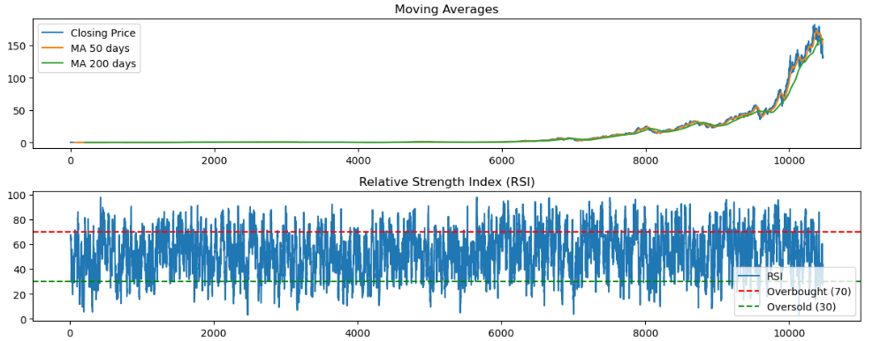
Continued

Slide 17
Conclusion
We have used a pre-existed dataset available in Kaggle for this EDA.
It turns out to be that Apple’s stock prices have increased rapidly from 2010-2022.
Since 2021, the Moving norms have been higher than the stock price, which can reflect that the stock may be in a decline and that recent performance has lagged behind historical norms.
It indicates that there is a significant association between the performance of Apple and the S&P 500 given that the correlation coefficient was calculated and came out to be 1.
For further EDA, we can explore more using different graph models like histograms etc.

Slide 18

THANK YOU

